Slide 1
Western United States
Presentation made by
Vira Lytvyn

Slide 2
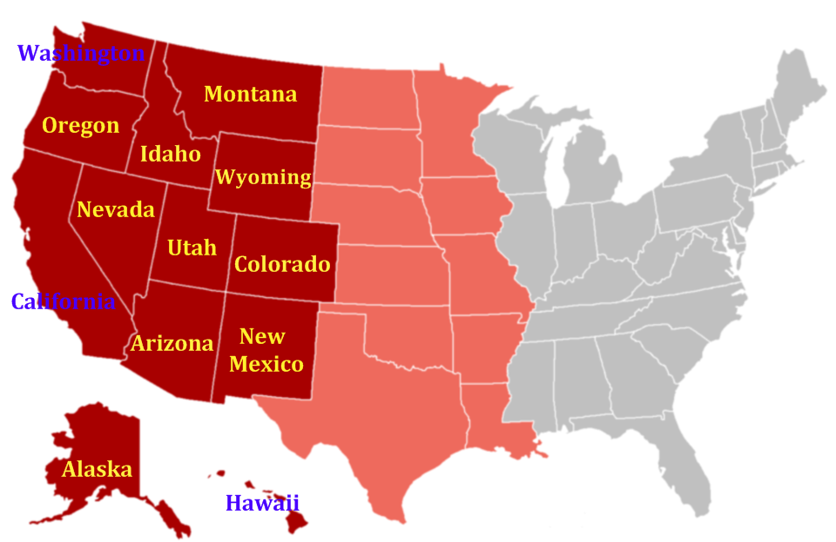
As defined by the Census Bureau, the western United States includes 13 states:

Slide 3
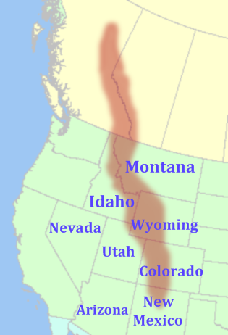
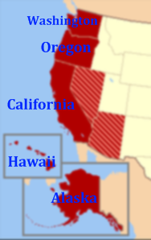
In turn, this region is sub-divided into Mountain and Pacific areas.
Pacific States
Mountain States

Slide 4
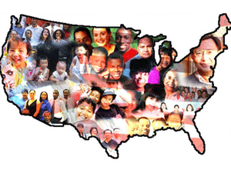
The Western United States has more males than females, than any other region in the United States.
Population
The West has been shaped by a variety of ethnic groups. Hawaii is the only state in the union in which Asian Americans outnumber white American residents. Asians from many countries have settled in California and other coastal states in several waves of immigration since the 19th century, contributing to the Gold Rush, the building of the transcontinental railroad, agriculture, and more recently, high technology.
The state of Utah has a Mormon majority (estimated 65-75% of the state's population), while some cities like Albuquerque, New Mexico, Spokane, Washington and Tucson, Arizona faces Indian Reservations of Native American tribes, and there are Alaskan Natives and Native Hawaiians to bring forth a great deal of racial diversity.
The largest concentrations for black Americans in the West can be found in Los Angeles, Oakland, Sacramento, San Francisco, Las Vegas, Denver, Colorado Springs and parts of Arizona.

Slide 5
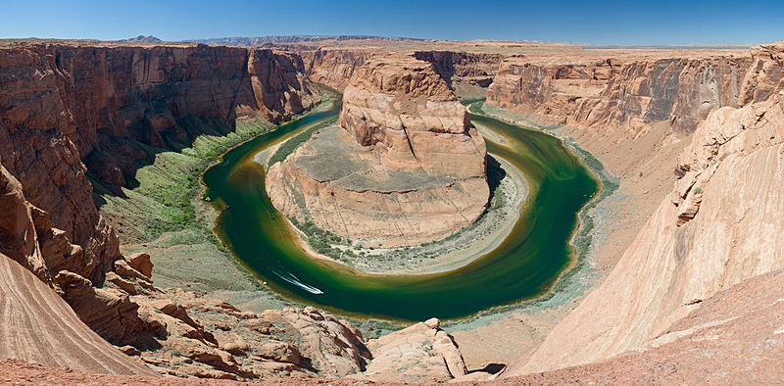
Rivers
The West has several long rivers that empty into the Pacific Ocean, while the eastern rivers run into the Gulf of Mexico. According to the United States Coast Guard, "The Western Rivers System consists of the Mississippi, Ohio, Missouri, Illinois, Tennessee, Cumberland, Arkansas and White Rivers and their tributaries, and certain other rivers that flow towards the Gulf of Mexico."

Slide 6
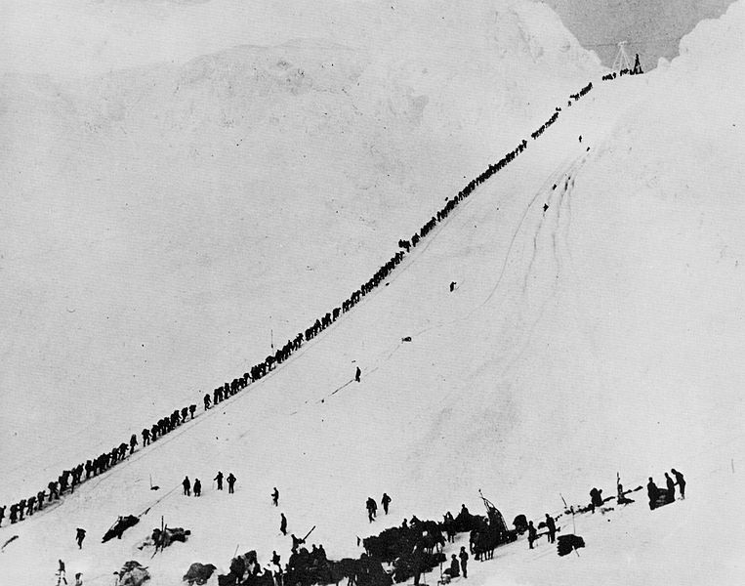
Riches
The West is reach in copper, gold, lead, molybdenum, silver, tungsten, zinc. The Wyoming Basin and several smaller areas contain significant reserves of coal, natural gas, oil shale, and petroleum. The Coeur d'Alene mine of northern Idaho produces silver, lead, and zinc.
There are major nuclear power plants, but also several cities such as Oakland, Berkeley and Davis have declared themselves as nuclear-free zones.
Agriculture and forestry are important industries. Agriculture includes dry land and irrigated farming and livestock grazing.
Miners and prospectors climb the Chilkoot Trail during the Klondike Gold Rush.

Slide 7
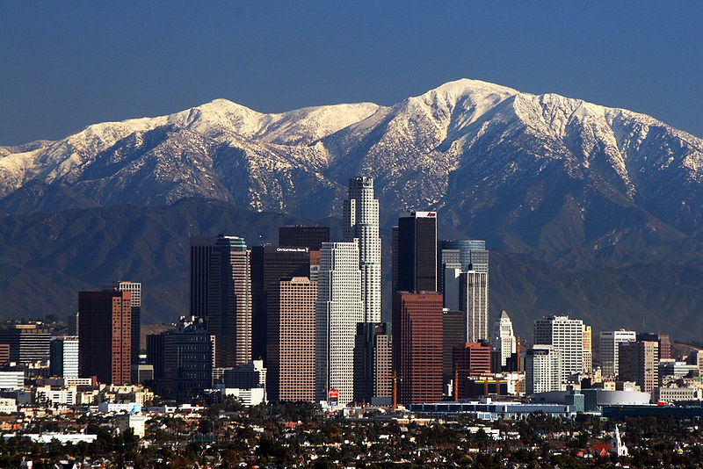
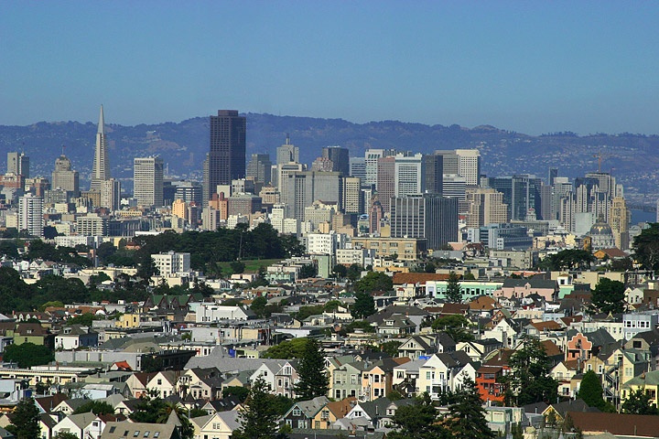
Major Metropolitan Areas
Los Angeles-Long Beach-Santa Ana MSA, California
San Francisco-Oakland-San Jose MSA, California

Slide 8
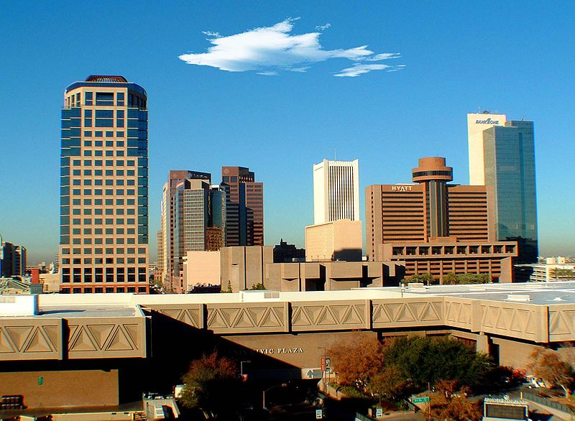
Major Metropolitan Areas
Phoenix-Mesa-Scottsdale-GlendaleMSA, Arizona

Slide 9
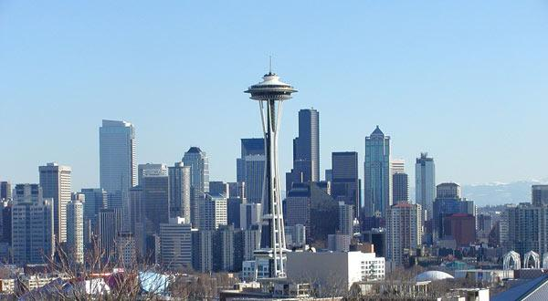
Major Metropolitan Areas
Seattle-Tacoma-Bellevue MSA, Washington

Slide 10
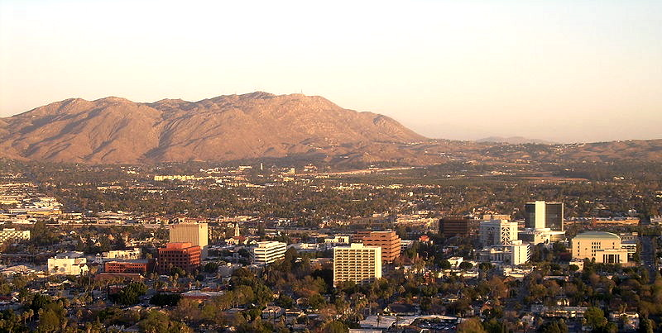
Major Metropolitan Areas
Riverside-San Bernardino-OntarioMSA, California

Slide 11
Tourism
Every year the scenic areas and recreational opportunities draw millions of tourists.
People from all over the world visit the sites to hike, camp, or engage in mountain sports.
Every state in the USA has some world famous sites sing. Many people know these places, but do not imagine what state they situated in.

Slide 12
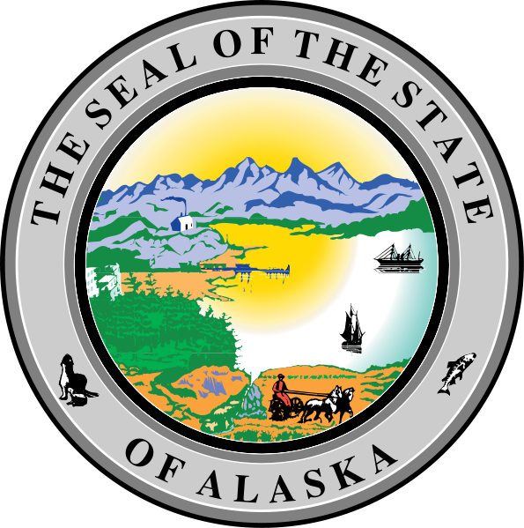
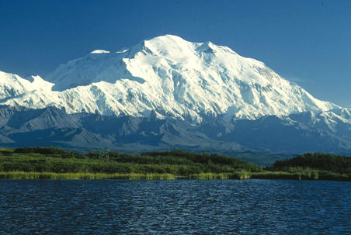
Mount McKinley is both the highest peak in Alaska and in all of North America.

Slide 13

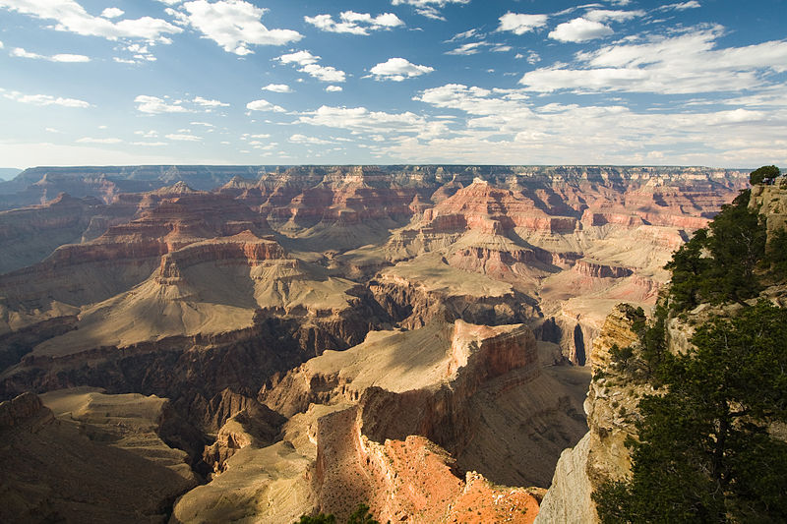
Grand Canyon

Slide 14

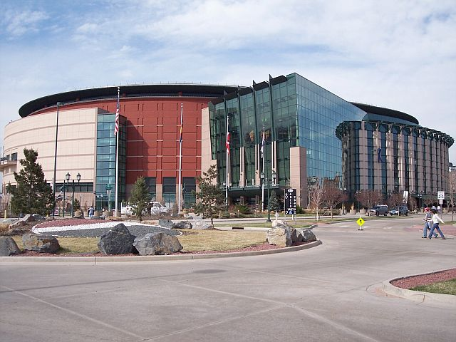
Pepsi Center in Denver, home of the Denver Nuggets National Basketball Association club, the Colorado Avalanche National Hockey League club, and the Colorado Mammoth National Lacrosse League club.

Slide 15
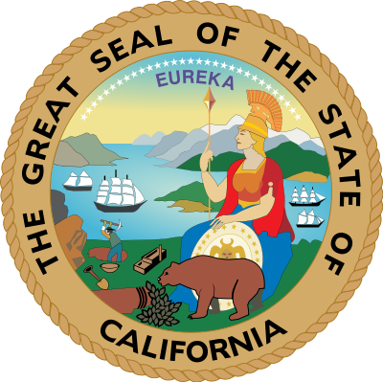
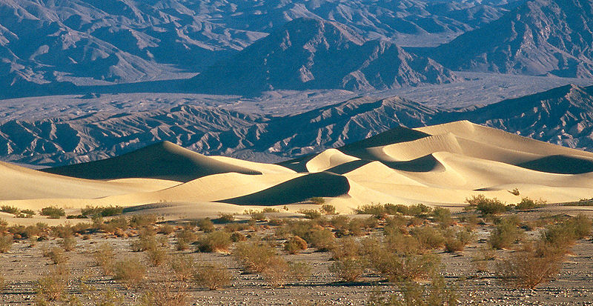
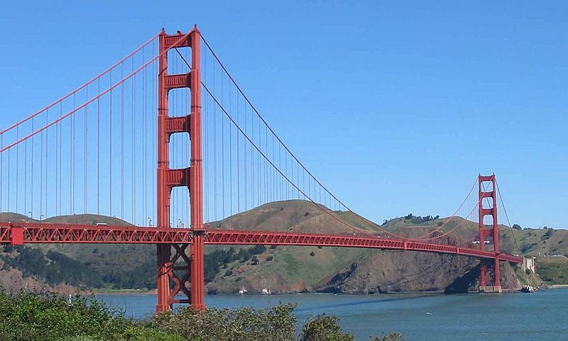
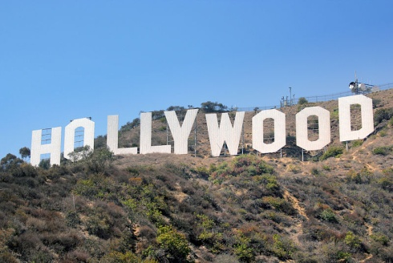
Death Valley
The Golden Gate Bridge in San Francisco, one of California's most famous landmarks.

Slide 16
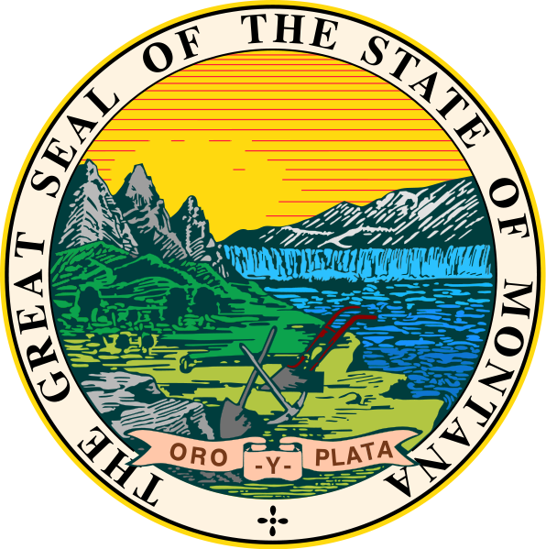
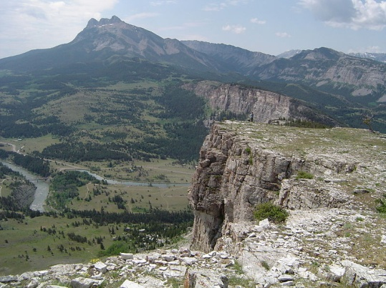
The headwaters of the Sun River, just below Gibson Reservoir

Slide 17
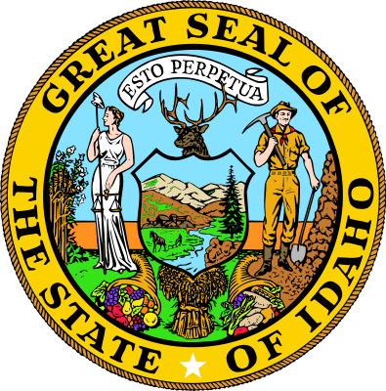
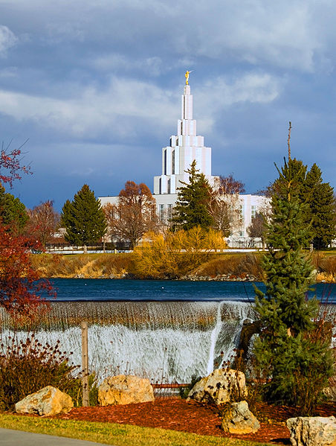
The Church of Jesus Christ of Latter-day Saints Idaho Falls Temple.

Slide 18
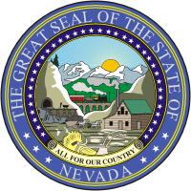
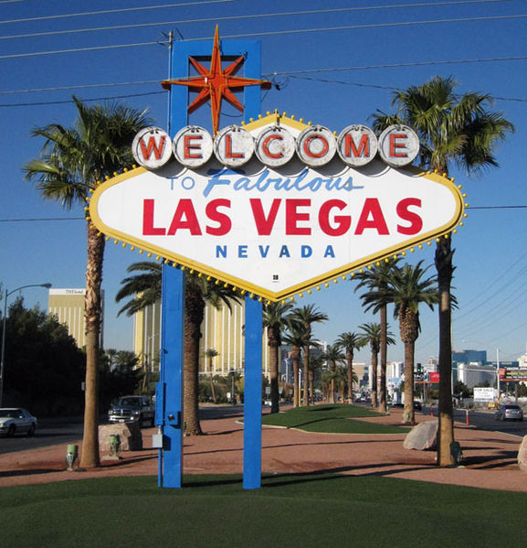
Gambling erupted once more following a recession in the early 20th century, helping to build the city of Las Vegas

Slide 19
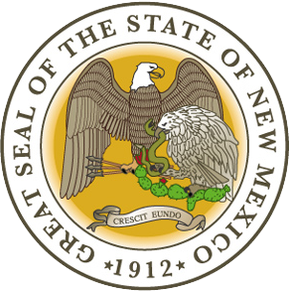
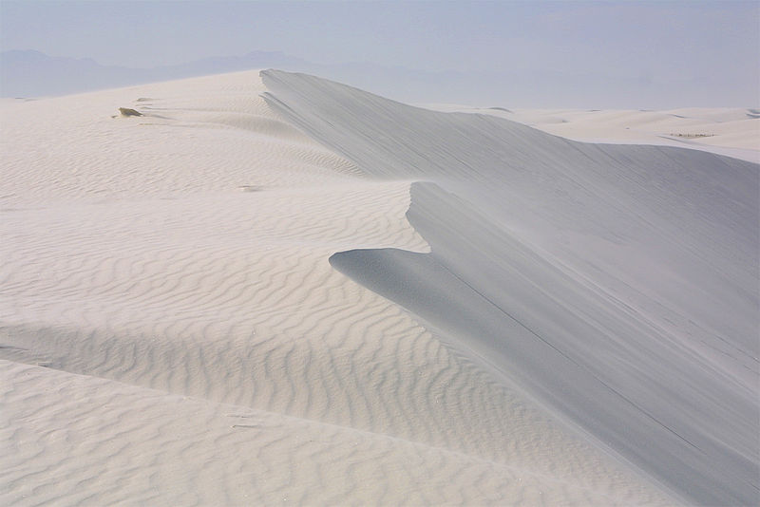
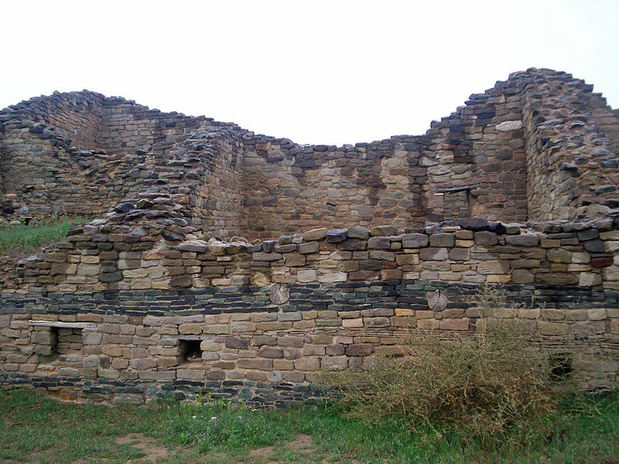
White Sands National Monument
Aztec Ruins National Monument

Slide 20
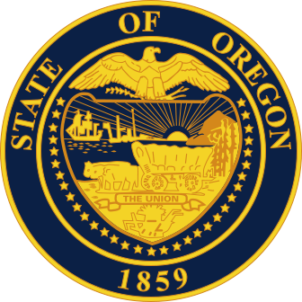
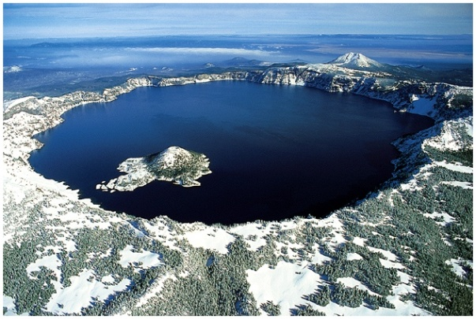
An aerial view of Crater Lake in Oregon

Slide 21

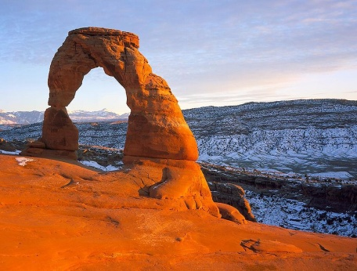
Delicate Arch, Arches National Park, Utah

Slide 22

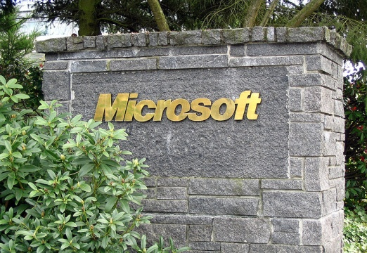
Microsoft Corporation headquarters in Redmond, an Eastside suburb of Seattle.

Slide 23
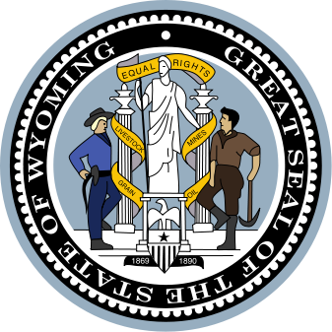
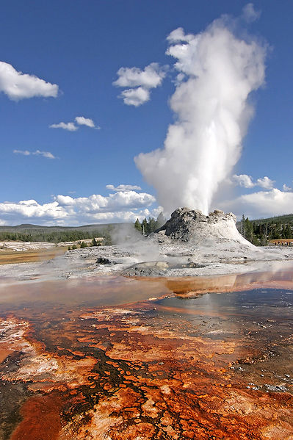
An eruption of Castle Geyser in Yellowstone National Park

Slide 24

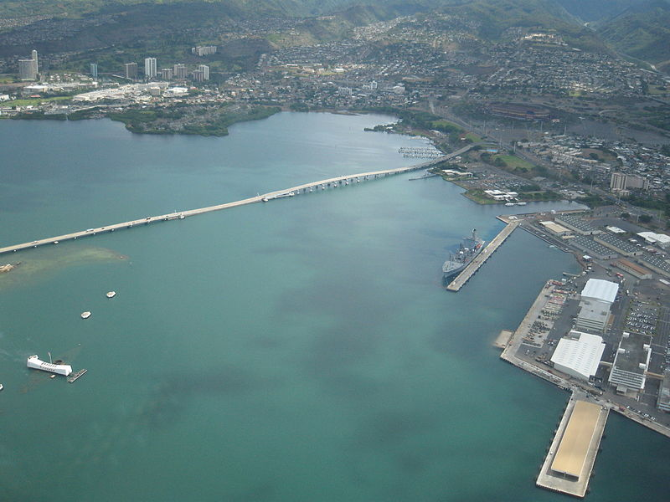
Part of Pearl Harbor, with Aloha Stadium, the USS Arizona, USS Bowfin (submarine), museums, Admiral Clarey Bridge, and naval yards visible.

Slide 25
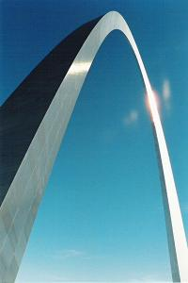
Generally
The West has a continuing reputation for being open-minded and for being one of the most racially progressive areas in the United States.
The Gateway Arch in St. Louis, also known as the "Gateway to the West", commemorates the westward expansion of the United States.

Slide 26
Thank you for attention ☺

